Slide 1
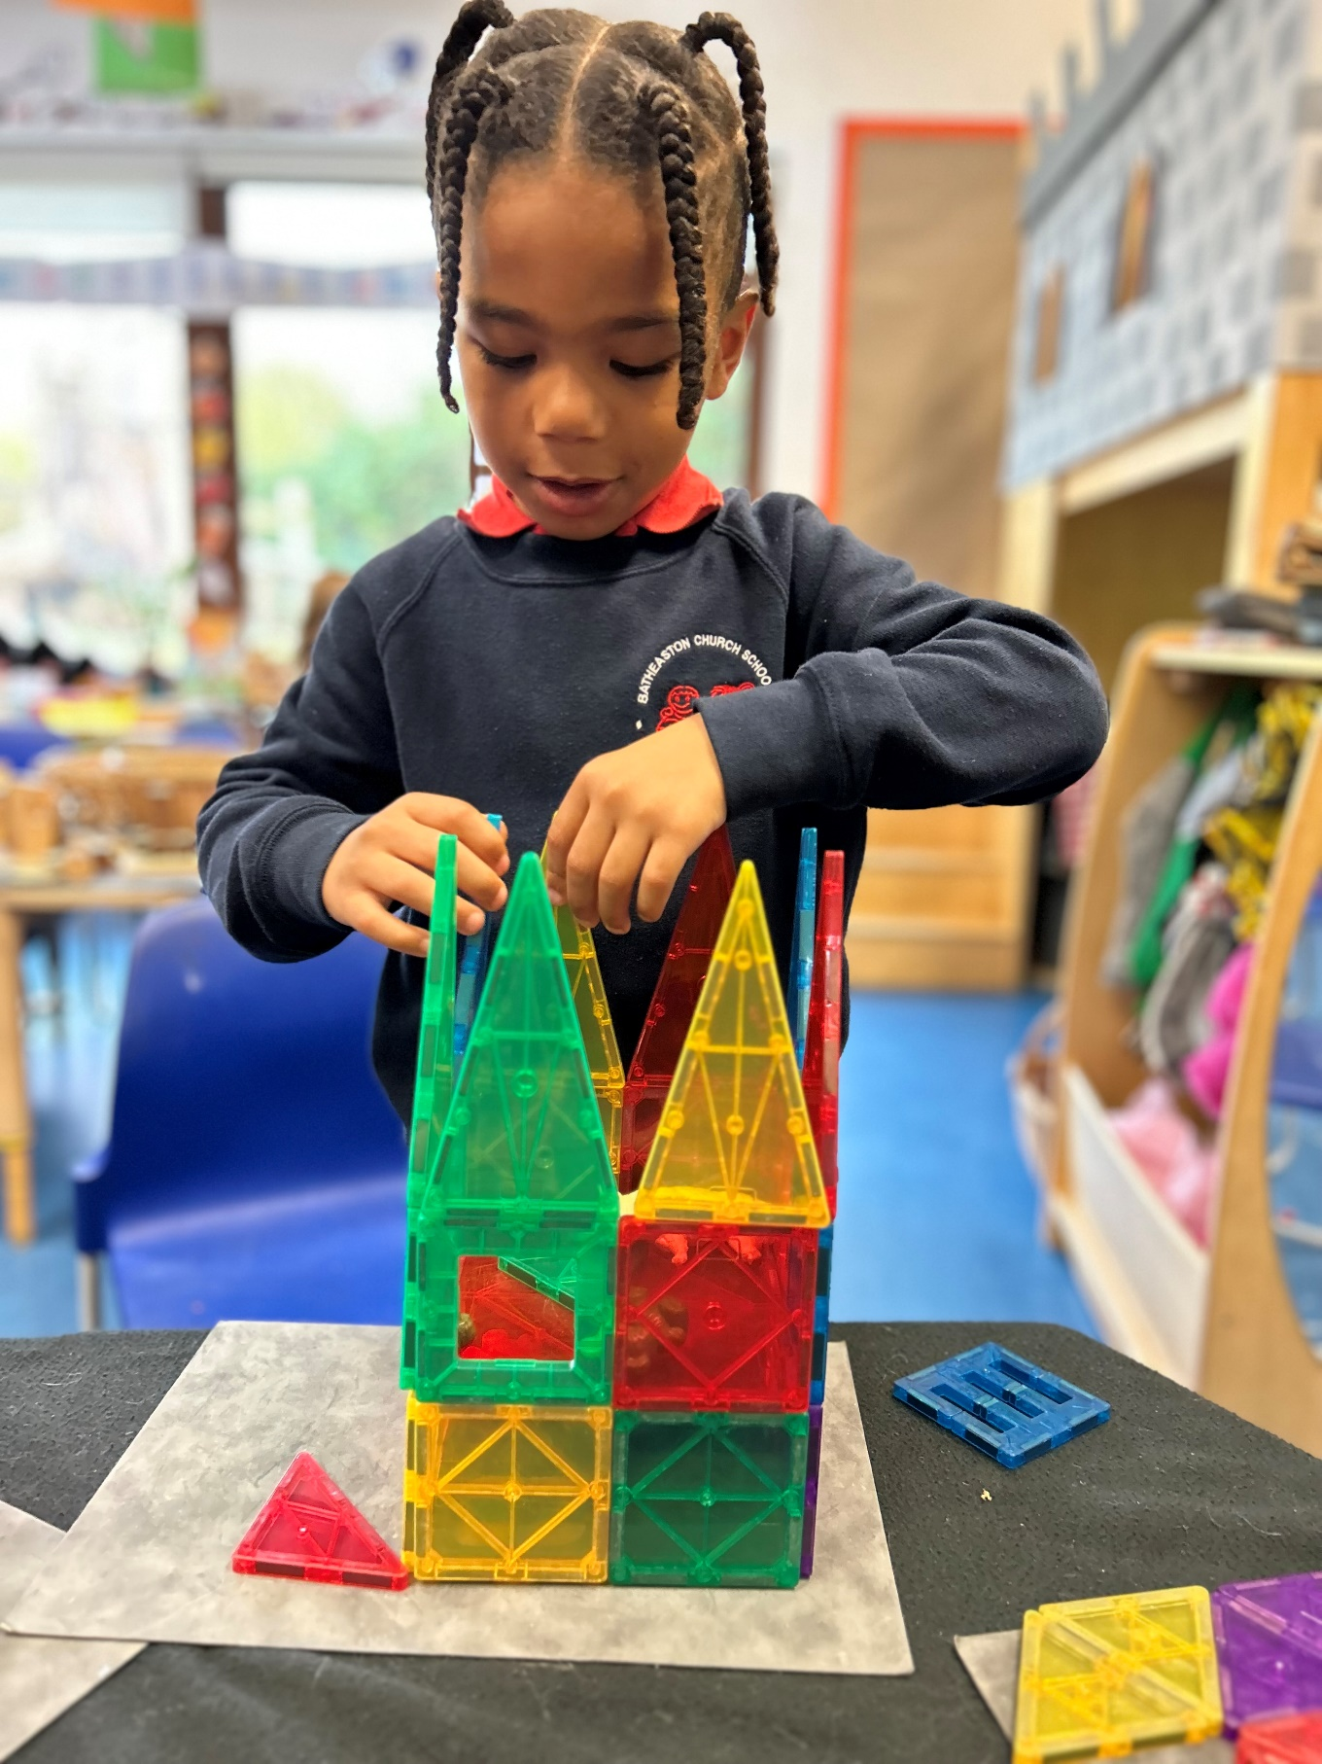
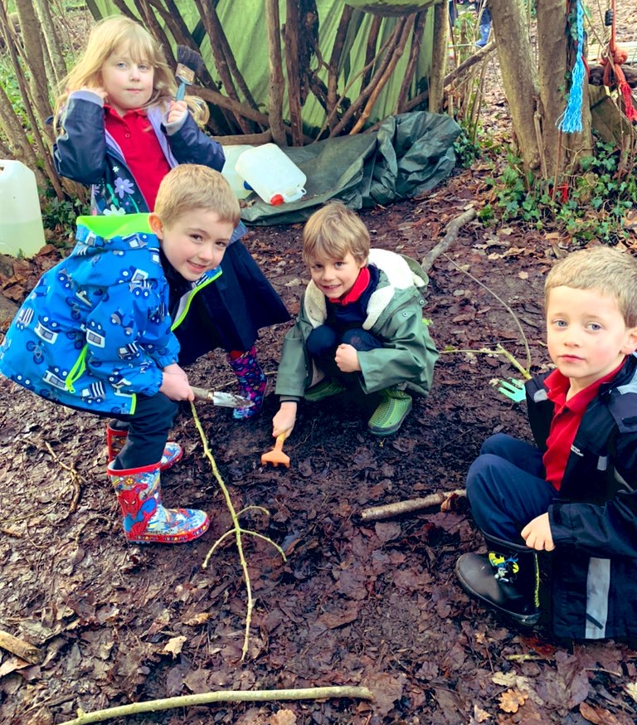
Welcome to Batheaston Church School
Website: batheastonprimary@co.uk
Follow us on Twitter: @batheastonPri

Slide 3
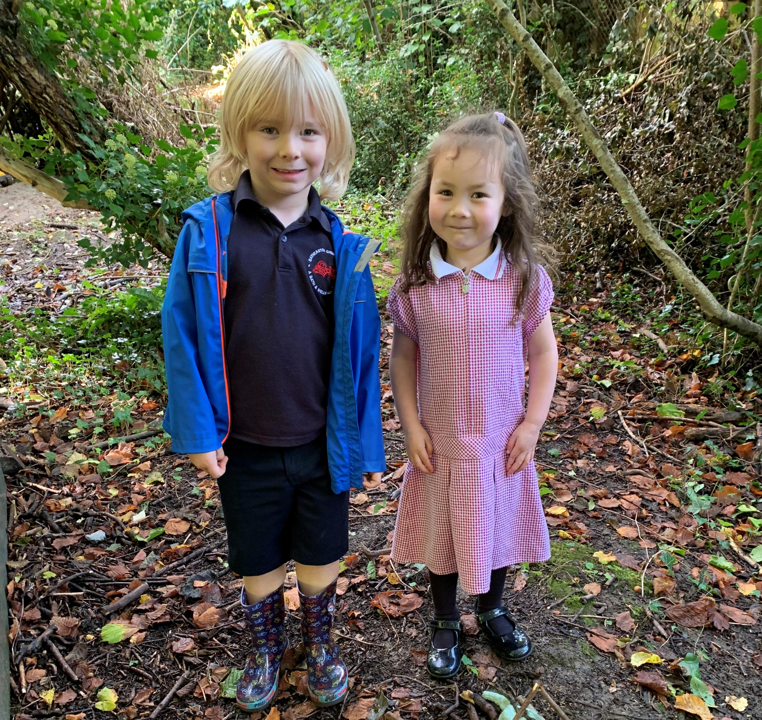
What is school readiness?
A collective responsibility in which parents, childcare professionals, teachers and other agencies play a significant role in preparing for school.
Key skills and characteristics:
Independence and self-sufficiency
Resilience and motivation
Curiosity about the world and a desire to learn
Social and emotional
Language development
Physical well-being

Slide 4
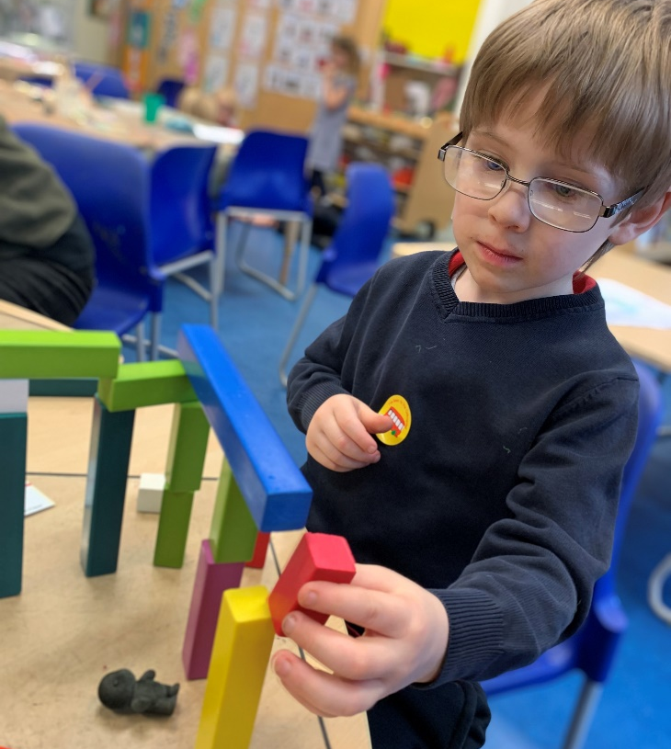
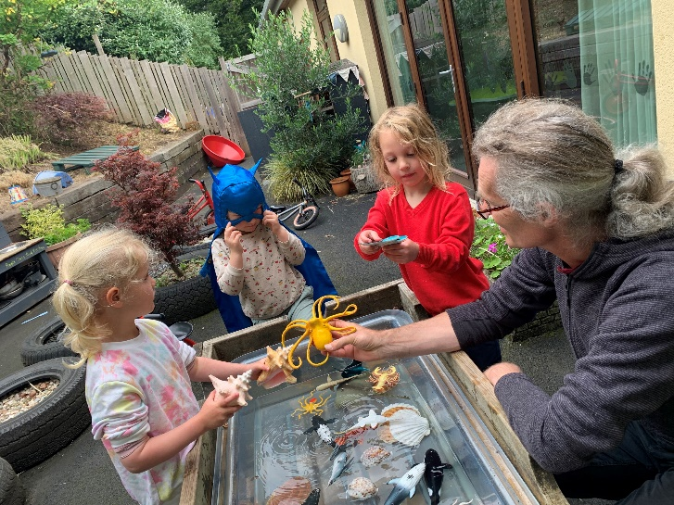
“The earliest years in a child’s life are absolutely critical. A child’s future choices, attainment, wellbeing, happiness and resilience are profoundly affected by the quality of the guidance, love and care they receive during these first years.”
Dame Claire Tickell
Independence – role play at home, practise getting dressed, putting on coat, socks etc. Nearer the time think about routines into morning.
Resilience - developing your child's coping strategies in the presence of risk or challenge. This can promote 'self-perception' or belief that they can accomplish a task.
Motivation - requires being attentive and present – this can be developed and nurtured through encouraging your child to persist, explore and be curious.
Social and emotional – talk positively about school, reflect upon friends they know already in school. When possible meet up for play dates.
Curiosity – Promote curiosity through play, going for walks, growing plants, building structures etc.
Language – promote reading through regular story times, talk and promote listening skills.
Physical well-being – being physically active, fine motor i.e. drawing, painting and constructing.

Slide 5
Key areas to support your child
Children’s independence skills are key! Putting on their coat, shoes socks etc.
Getting changed for P.E
Using a cutlery
Being able to sit and listen to a story or take part in a conversation.
Toileting
Separation in the mornings - learning to say goodbye!

Slide 6
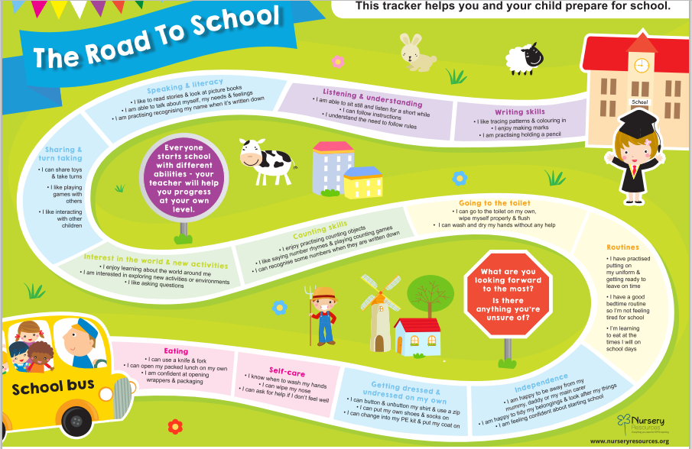
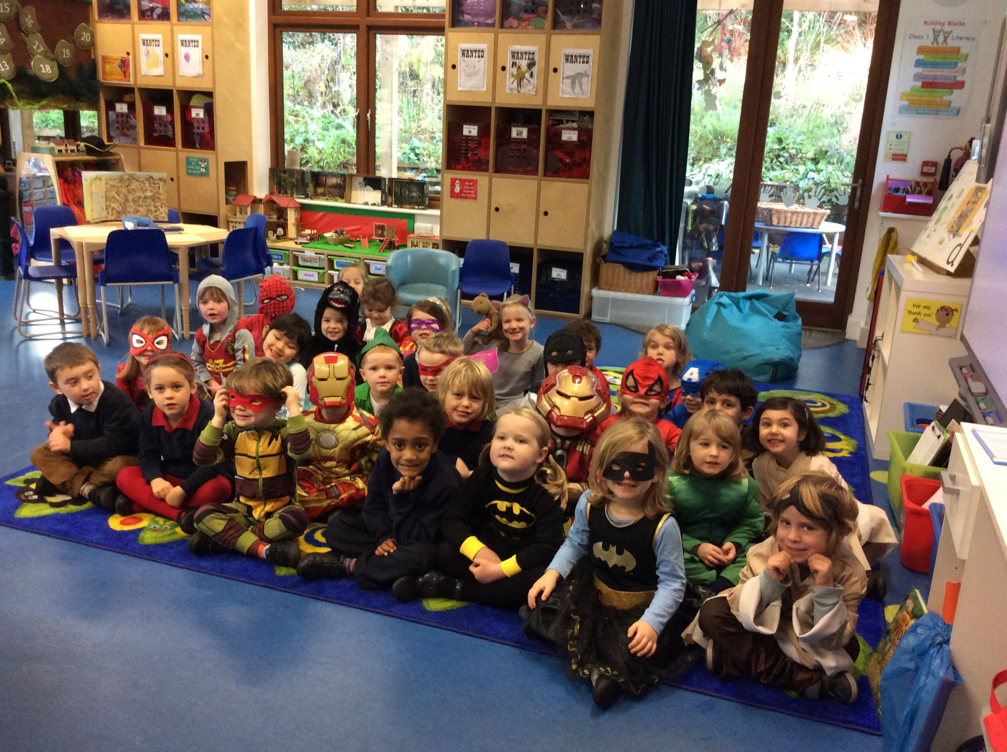

Slide 7
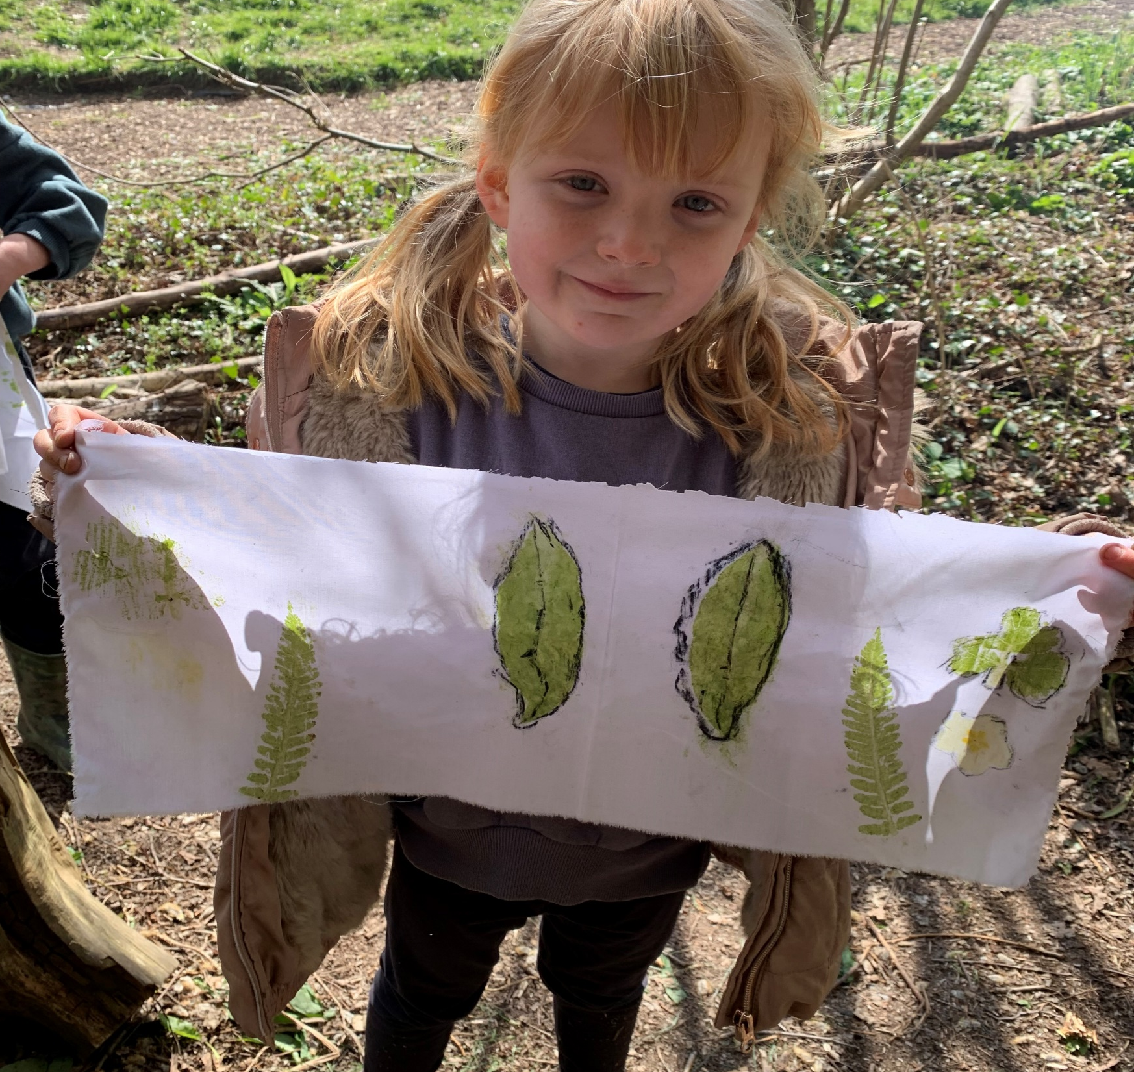
Key Requirements Learning and Development
EYFS has 7 learning areas – 3 PRIME and 4 SPECIFIC
PRIME:
1. Personal, Social and Emotional
2. Communication and Language
Development
3. Physical Development
SPECIFIC
1. Literacy
2. Maths
3. Understanding the World
4. Expressive Arts and Design

Slide 8
Tea Break!

Slide 9
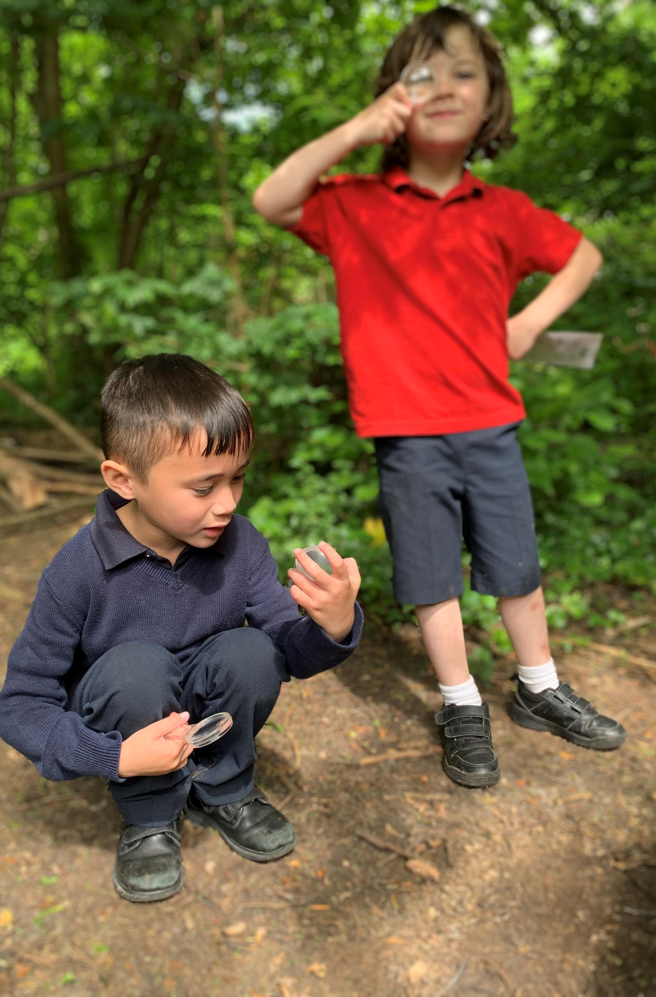
Induction at Batheaston
Why a staggered start?
Over 3 weeks the children are part-time so they gain an essence of the school day but in a smaller setting.
Smaller groups means we as a staff can get to know the children gradually and vice versa they get to know and trust us as their carers.
Although your child may have been at pre-school full-time, this does not equate as the same as a school day – they will get tired!
Gives us the time and space to make the initial Baseline assessments.

Slide 10
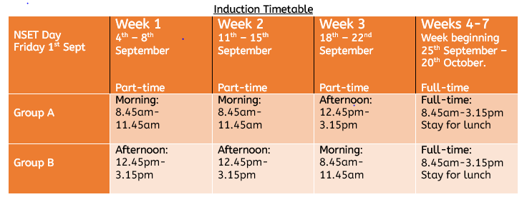
Term starts on Monday 4th September
Induction structure for September 2023

Slide 11
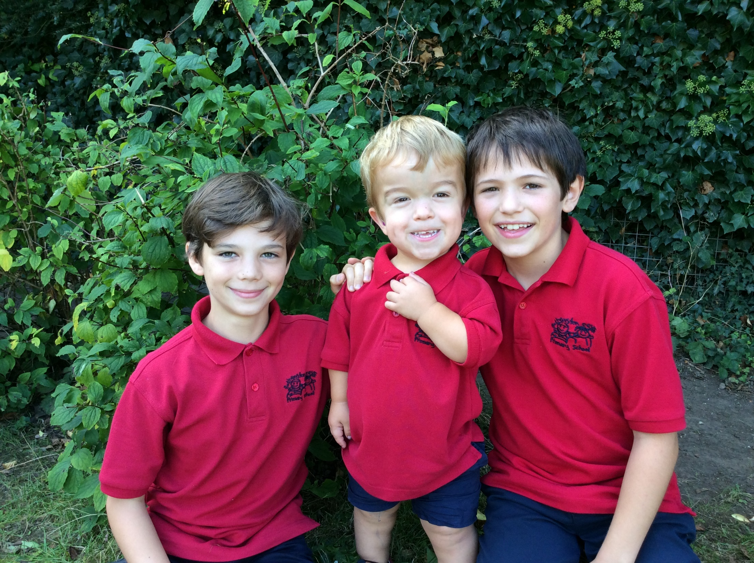
Special Friends

Slide 12
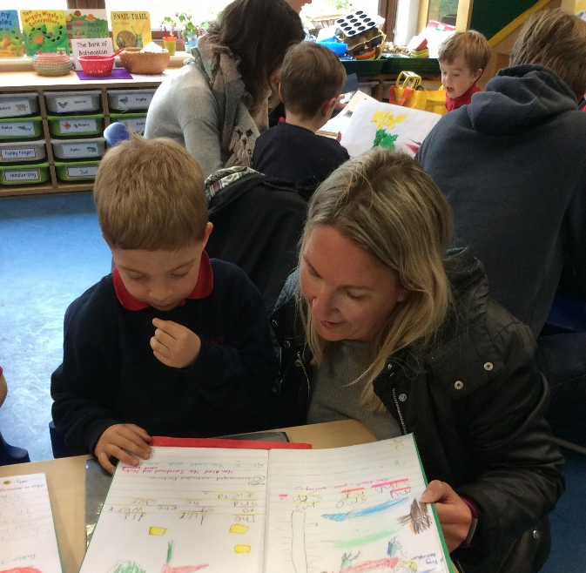
Parent Partnerships

Slide 13
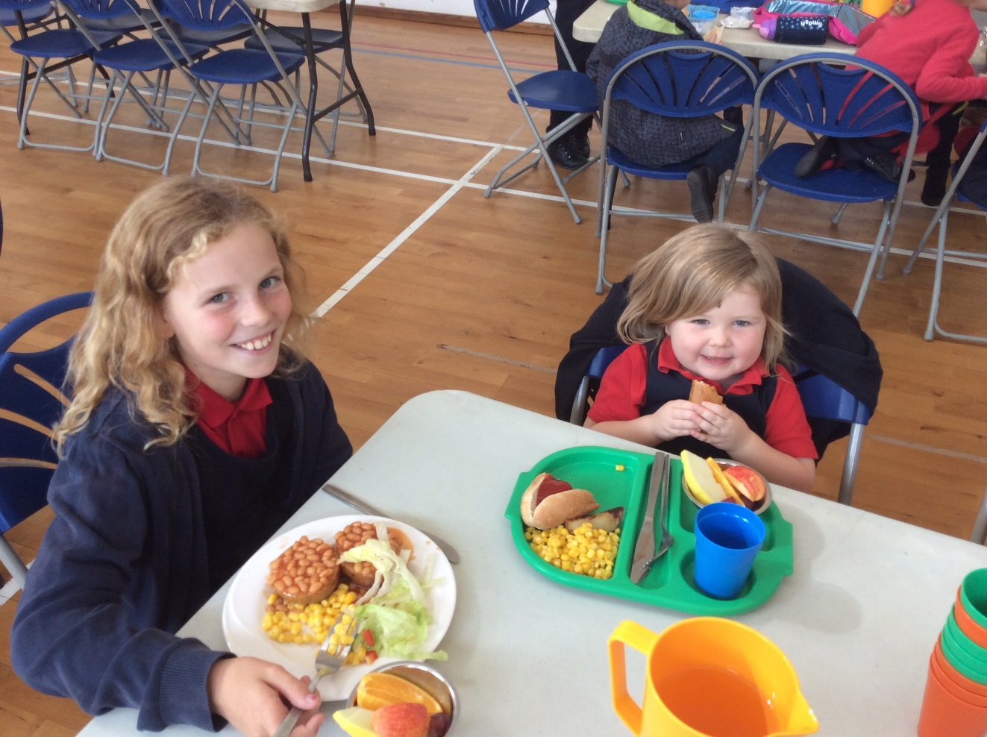
All children in Reception, Year 1 and 2 have access to free school dinners.
However, if you are on benefits you are entitled to more funding called Pupil Premium.
Free school dinners

Slide 14
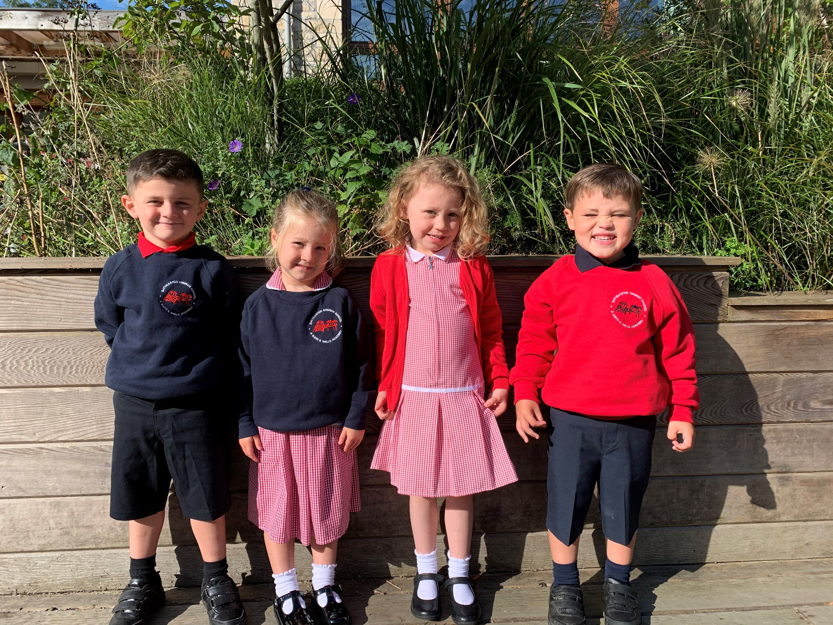
School Uniform
Michael Hope
Please order online.
http://michaelhope.co.uk/

Slide 15
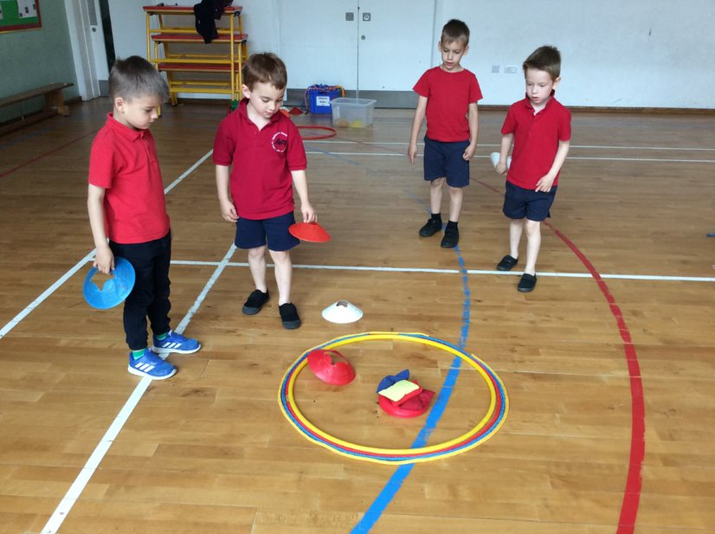
PE Kit
T-shirt (preferably red or navy)
Shorts
Tracksuit bottoms
Daps/plimsols (but not needed at start)
PE bag
Spare clothes and underwear in a separate bag.
Please name all clothes and shoes!
EXTRAS
Welly boots!

Slide 16
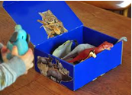
Summer Project
Ask your child to decorate an old shoe box and place inside 5 items of importance to them. In the past children have put in photos, favourite toys, a book or something they have collected during a holiday. Please bring in the box during the first week of school and we will look through each box together. We have found that this is a really lovely way of finding out about each other in the first few weeks of term.

Slide 17
Questions!

